Slide 1

Digital Transformation Proposal
Zeeshan Shaikh
23rd Sept 2020

Slide 2
Requirements Captured
Current IT Environment leverages Hybrid Cloud setup. Solutions/ Services used:
Private Cloud: VMWare
Public Clouds: Amazon Web Services and Microsoft Azure
Current Strategy: To increase productivity from IT assets and people
Category | Problem Statement
OpenCompute Adoption | Bank is interested in OpenCompute, however hardware's are purchased from traditional vendors like HP, IBM, CISCO, EMC, etc.
Application Modernization | Changes the bank makes sometimes disrupt their upgrade paths. Additionally, the agents and other modifications to VM/ Cloud images are done by the vendor and take weeks
Network Automation | Network changes take significant manpower to be executed from respective teams, which further delays delivery
Operational Cognizance | Holistic view of Security, regulatory compliance and performance is required
“A cut above” Management solution | Unable to on-board new capabilities or providers in the current hybrid solution due to management platform not keeping pace with the industry and being proprietary
**Aspirational Target: To reduce Average Transaction cost (US $0.001 from US $0.07)

Slide 3
Agenda
Proposed Technology Stack
OpenCompute Adoption
Application Modernization
Network Automation
Operational Cognizance
“A cut above” Management Solution
Proposed solution benefits
How to reduce average transaction costs
Demo of Red Hat OpenShift Q & A session

Slide 4
Proposed Full Technology Stack - Red Hat Hybrid Cloud
App
App
App
Security & Management Plane
Developer Tools
App
Container
Red Hat Ansible Platform
Red Hat Insights
Red Hat Satellite
Red Hat CloudForms*
Red Hat Runtimes
Red Hat CodeReady Workspaces
Red Hat Quay
Container
Red Hat OpenShift Platform
Virtual Machines
Containerization Tier
Red Hat OpenStack Platform
Hypervisor Management Tier
Hypervisor Tier
Red Hat Enterprise Virtualization
Foundation Tier
Red Hat Enterprise Linux
Red Hat Ceph
Storage Tier
Physical Infrastructure (Any certified hardware)
Better Software Architecture
Agile Integration
Streamline Application Lifecycle
Continuous Innovation
Notes:
*Red Hat CloudForms has been merged with IBM Cloud Pak for MultiCloud Management solution and will not be sold by Red Hat anymore

Slide 5


OpenCompute Adoption + H/W from traditional vendors
OpenCompute
Nokia
Inspur
Wiwynn
Strong contributor to OpenCompute project since 2011
Traditional H/W
Cisco UCS series
Dell EMC PowerEdge series
HPE ProLiant DL servers
What is Red Hat OpenStack Platform? Why?
A Cloud Computing framework; controls large pools of compute, storage and networking
Switch from virtualization to Cloud
Installation of bare-metal servers

Slide 6


Application Modernization
Application Lifetime
Deployment Process
Application Architecture
Deployment & Packaging
Application Infrastructure
CMO
Days/ Weeks
Agile
N-Tier (SOA)
Virtual servers
Datacenter/ Hosted
Proposed FMO
Hours/ Days
Agile + DevOps
Micro Services
Containers
Cloud
DEV
OPS
OPS
Benefits:
Frequent Deployments
Lower change of failure rates
Self-Service Environments
Dynamically Placed Applications
Declarative Service Deployments
Blue-Green and Canary releases
Self-Healing
Auto-Scaling
BUILD
SHIP
RUN
Development Environment
Secure Content & Collaboration
Deploy, Manage and Scale
Red Hat OpenShift Container Platform:
An open-source container application platform for the development, deployment and management of applications. Built on Kubernetes

Slide 7
Scenario: Zero downtime Upgrade process in RHOCP
SCM Tool
Build Management System
Source-To-Image conversion
Repository
Load Balancer
Cluster
Node
Node
Node
Pod
v1
Pod
v1
Pod
v1

Slide 8
Scenario: Zero downtime Upgrade process in RHOCP
v2
SCM Tool
Build Management System
Source-To-Image conversion
Repository
Load Balancer
Liveness probe
Readiness probe
Termination Grace Period
Cluster
Node
Node
Node
Pod
v1
Pod
v1
Pod
v1
Pod
v2

Slide 9
Scenario: Zero downtime Upgrade process in RHOCP
v2
SCM Tool
Build Management System
Source-To-Image conversion
Repository
Load Balancer
Liveness probe
Readiness probe
Termination Grace Period
Cluster
Node
Node
Node
Pod
v1
Pod
v1
Pod
v1
Pod
v2
Pod
v2

Slide 10
Scenario: Zero downtime Upgrade process in RHOCP
v2
SCM Tool
Build Management System
Source-To-Image conversion
Repository
Load Balancer
Liveness probe
Readiness probe
Termination Grace Period
Cluster
Node
Node
Node
Pod
v1
Pod
v1
Pod
v1
Pod
v2
Pod
v2
Pod
v2

Slide 11
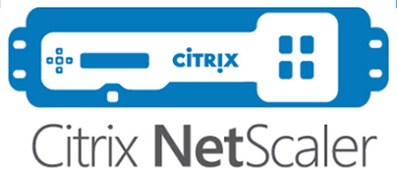











Network Automation
A simple IT Automation platform; makes systems and applications easier to deploy, configure and manage
Ansible Automation Platform = Ansible Engine + Ansible Tower (GUI)
Agentless, Infrastructure as YAML
What can be automated?
Configuration Management
DDI (DNS, DHCP, IPAM)
Security Policy Management
ITSM
Examples:
Network devices upgrades
Generate router configuration for new branch or ATM
Create a VPN communication between heterogeneous network devices
Benefits:
Less manpower needed
Error-free configurations
Tiny learning curve
Load Balancers, GTM
WAF
DDI
Firewall
Wireless

Slide 12

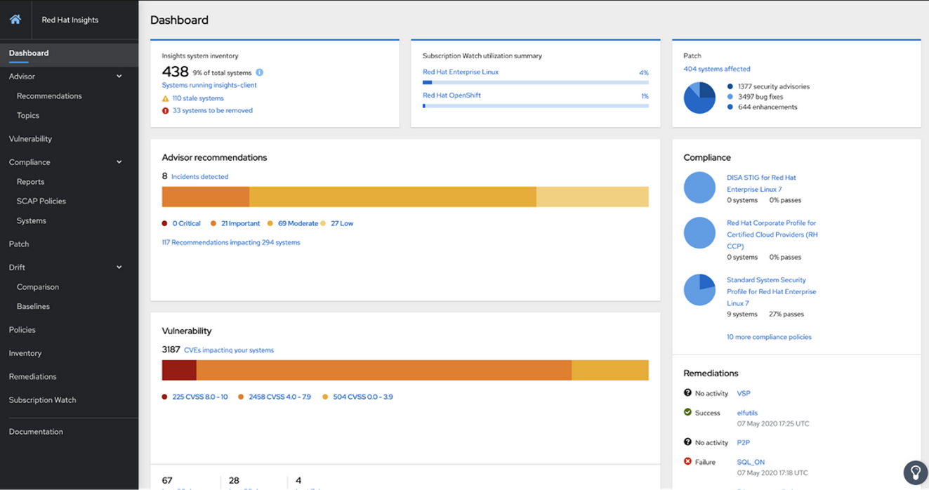
Operational Cognizance
A predictive in-depth analysis SaaS; generating actionable insights
Advisor
Vulnerability
Compliance
Patch
Drift
Policies
Benefits:
In-depth analysis for security, compliance, performance, availability and stability weaknesses
Avoid downtime
Comparison and custom policy capabilities
Automated remediation via Ansible Playbook
Inventory
Remediations
Subscription Watch

Slide 13




“A Cut Above” Management Solution
Red Hat CloudForms - A Cloud Management Platform, providing single management interface and enabling cross-platform orchestration
Infrastructure Providers
Cloud Providers
Container Providers
Network Providers
Configuration Management Providers
Automation Providers
Storage Providers
Self-Healing capability
Red Hat CloudForms
+
Red Hat Ansible Platform
Amazon CloudWatch
Amazon CloudWatch
Amazon CloudWatch
VPC
VPC
VPC
Load Balancer
Load Balancer
Load Balancer
Appserver-01
Appserver-02
Appserver-01
Appserver-02
Appserver-01
Appserver-02
Appserver-03

Slide 14



Proposed solution benefits
Delivering Agile Operations
Lowering IT
Infrastructure costs
Improved Business results
Increasing Team productivity
Other Benefits of partnering with Red Hat
Consulting
Training
24x7 Support
Notes:
GitHub Link for Red Hat Solutions Business Value and Awards: https://github.com/shaikhzeeshan31/Red-Hat-Study-Reports-and-Awards

Slide 15
Reduction in Average Transaction Cost
DIGITALIZATION
Present
Introduce Digital workforce
Adopting digital methods
Promote Digital payments
Future
Adopting Blockchain-As-A-Service for Payments and remittance
Elrond’s transaction costs report

Slide 16

Logical Architecture - Digital Work Force
User initialing chat with ALFRED using WhatsApp with a greeting message “Hi”
Hi
Red Hat 3Scale API Management
Red Hat Data Grid
Red Hat AMQ
Email
SMS
NLU/NLP Engine
Orchestration Engine
Account Information
Bank Policies
Red Hat OpenShift Container Platform
Database clusters (Sybase, Oracle, DB2, MongoDB, etc.)

Slide 17
Logical Architecture - Digital Work Force
Chatbot responding to User back with greeting response “Hi! This is ALFRED, your personal digital assistant”
Hi
Hi! This is ALFRED, your personal digital assistant
Red Hat 3Scale API Management
Red Hat Data Grid
Red Hat AMQ
Email
SMS
NLU/NLP Engine
Orchestration Engine
Account Information
Bank Policies
Red Hat OpenShift Container Platform
Database clusters (Sybase, Oracle, DB2, MongoDB, etc.)

Slide 18
Demo
Run a Java Spring application on Red Hat OpenShift Dedicated (Deployment option – S2I)

Slide 19
Q & A

Slide 20
Thank You!

